Slide 1


AGENTIC AI ENGINEERING COURSE

Slide 2



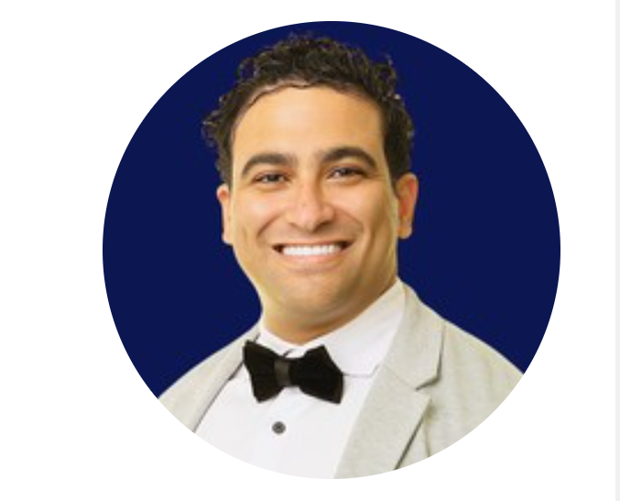





Instructor Introduction
500,000+ Students
M.A.Sc., Ph.D., MBA
250,000+ Subs, 3M views
Dr. Ryan Ahmed Professor & Best-selling Instructor
© All rights reserved for Dr. Ryan Ahmed @Stemplicity Inc.
AI & EV/AV
Taught L1 & 2 Python & AI

Slide 3
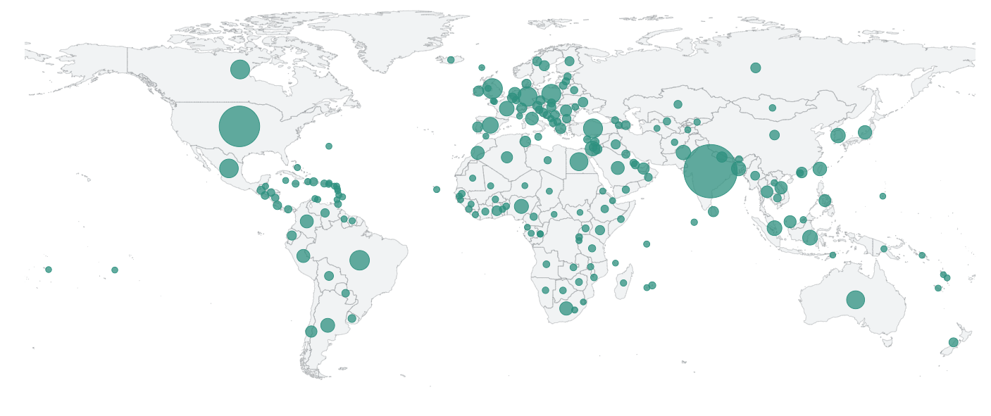











Global Students Reach
© All rights reserved for Dr. Ryan Ahmed @Stemplicity Inc.

Slide 4







AI Agent Demo
AI agents are smart systems, often powered by large language models (LLMs) like GPT-5 that take your goal, figure out the steps, and then use tools to get things done with little to no supervision.
AI Agent
Guardrails
Book a Hotel in Mexico City from December 18 to 28, budget is 300
LLM
Handoffs
© All rights reserved for Dr. Ryan Ahmed @Stemplicity Inc.
Planning
Tools
Memory

Slide 5
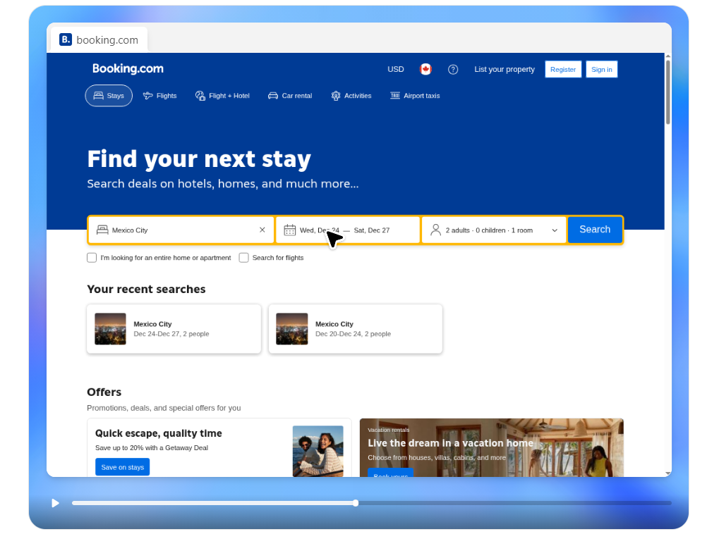
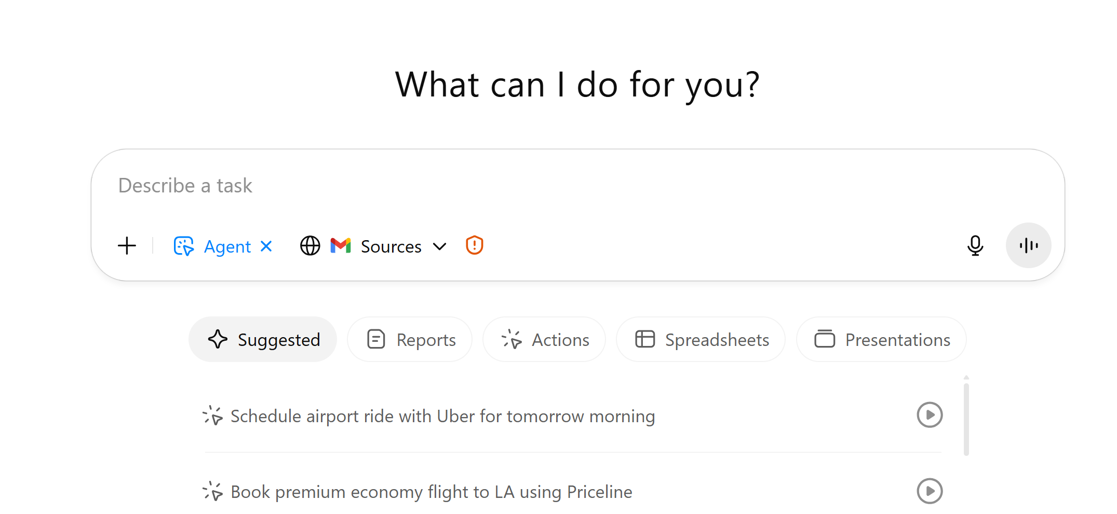
Agent Mode
© All rights reserved for Dr. Ryan Ahmed @Stemplicity Inc.

Slide 6
COURSE OUTLINE

Slide 7
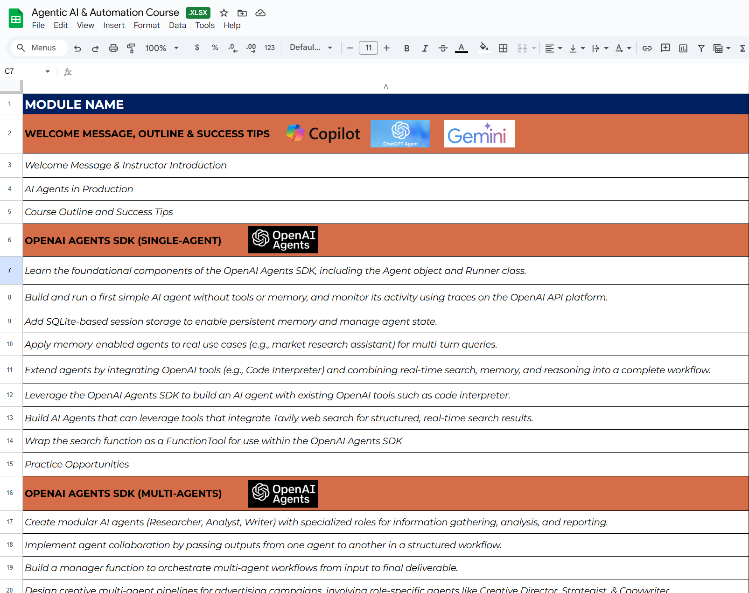
Course Outline
Check the course outline here:
© All rights reserved for Dr. Ryan Ahmed @Stemplicity Inc.

Slide 8
COURSE KEY SUCCESS TIPS

Slide 9
Success Tips
Learn by Doing!
Build a Portfolio of Projects
Solve Practice Opportunities
Leverage LinkedIn to share your work & maximize Reach!
© All rights reserved for Dr. Ryan Ahmed @Stemplicity Inc.
LinkedIn Link: https://www.linkedin.com/in/dr-ryan-ahmed/

Slide 10
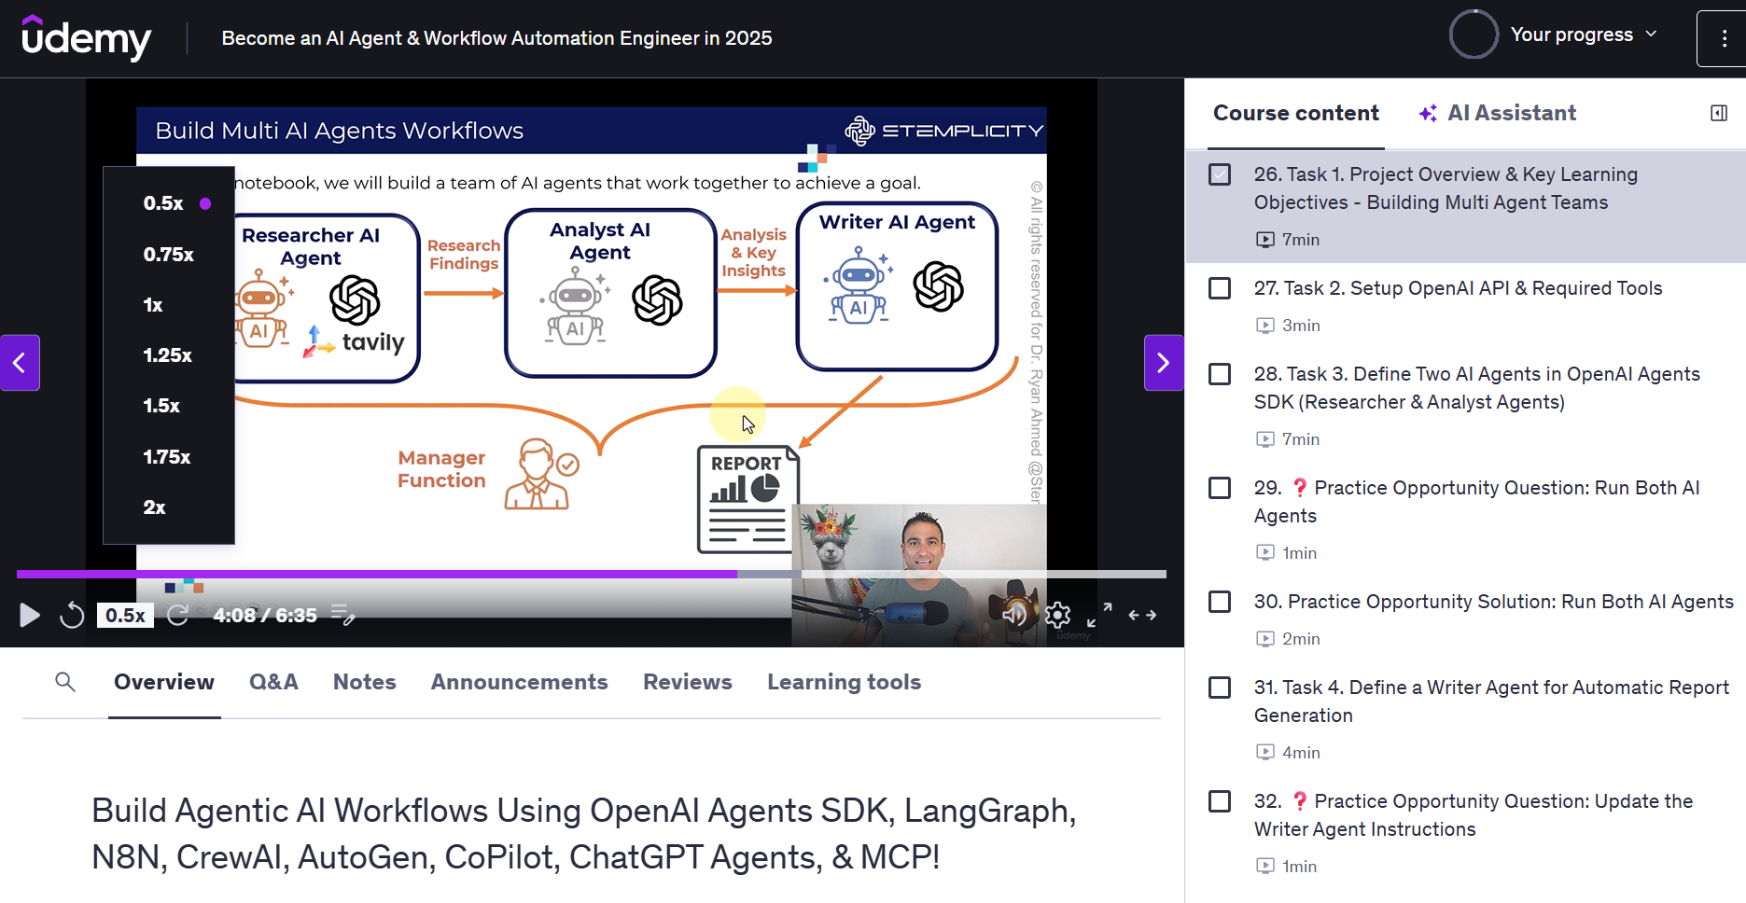
Change video Speeds
You have the option to play lectures at different speeds: (.5x, 1x, 1.25x, 1.5x or 2x)
In the bottom-left corner of the video, you can change the speed of the video.
© All rights reserved for Dr. Ryan Ahmed @Stemplicity Inc.

Slide 11
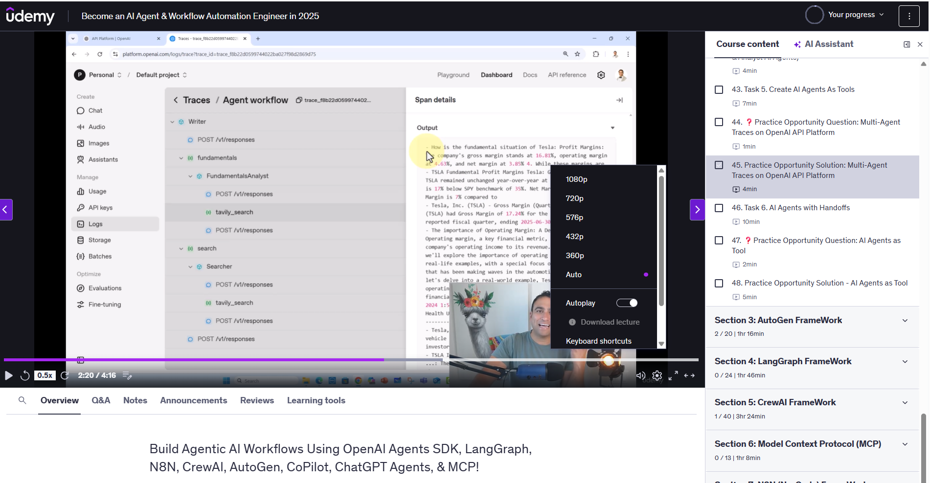
Change the video quality
Udemy automatically optimizes video resolution based on your internet connection speed. Alternatively, you can select 360p, 480p, and 720p resolutions for the video quality.
All course lectures are filmed with HD quality 1080p.
© All rights reserved for Dr. Ryan Ahmed @Stemplicity Inc.

Slide 12
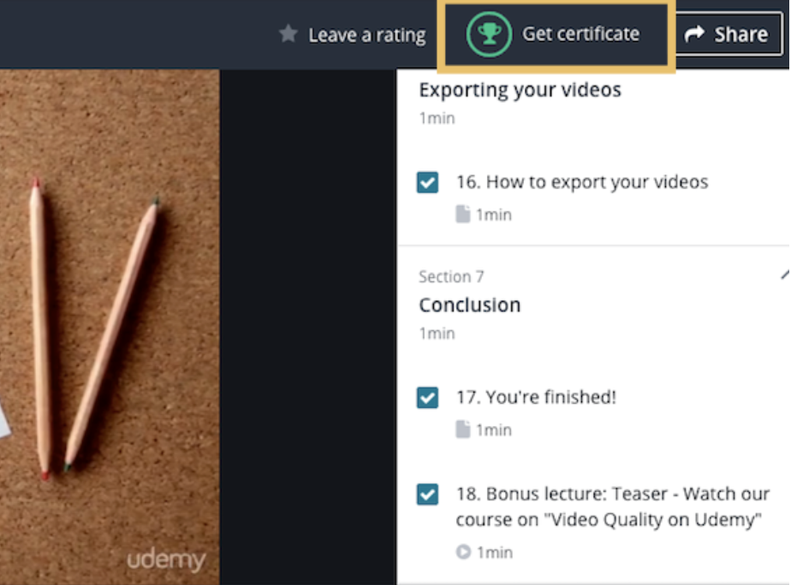
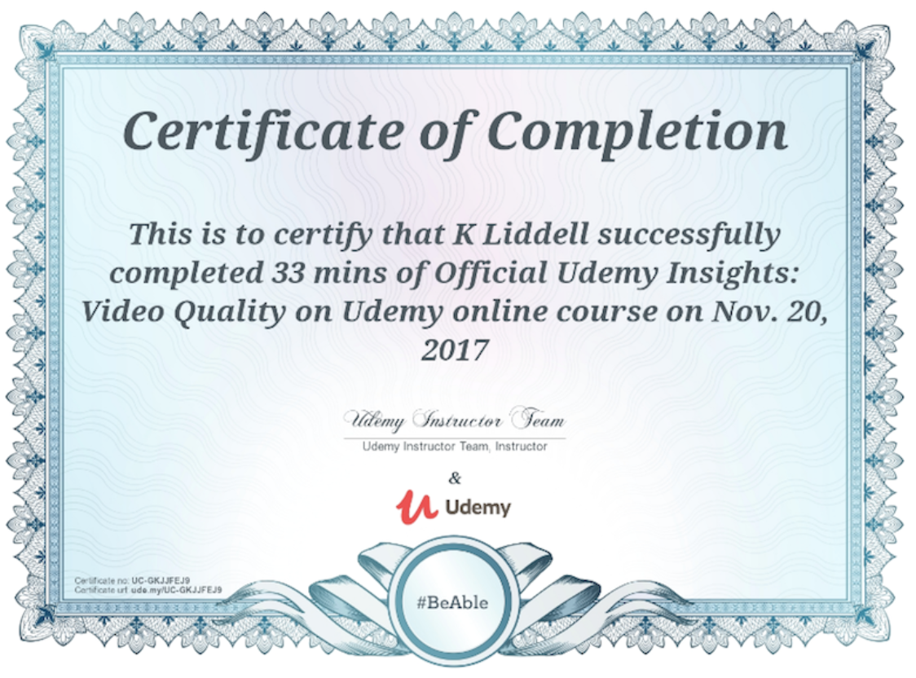
How do you get the Certificate of Completion?
When you complete all course modules, you will receive a certificate of completion.
© All rights reserved for Dr. Ryan Ahmed @Stemplicity Inc.

Slide 13
Thank you!

